Slide 1
The Reinforcement Learning Problem

Slide 2
Objectives
Problem definition
Agent, Environment, States, Observations, Actions and Rewards
The learning cycle
Steps, Episodes and Experience
Challenges
delayed consequences, exploration vs exploitation, learning from sampled feedback
Markov Decision Process
The Transition function
The Reward function
The Return
Example: the frozen lake
Plan and Policy

Slide 3
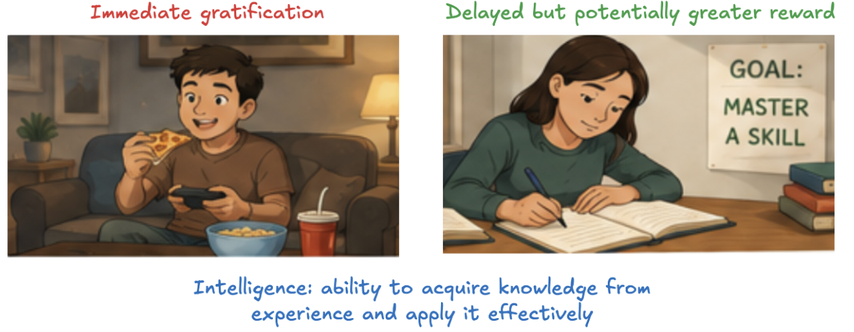
Problem definition
Humans naturally look for happiness
from picking out our meals…
…to advancing our careers
Every action we take is driven by our desire for rewarding experiences
Reinforcement learning (RL) is the task of learning through trial and error
no human labels data
no human collects or explicitly designs the collection of data
the goal in RL is to act

Slide 4
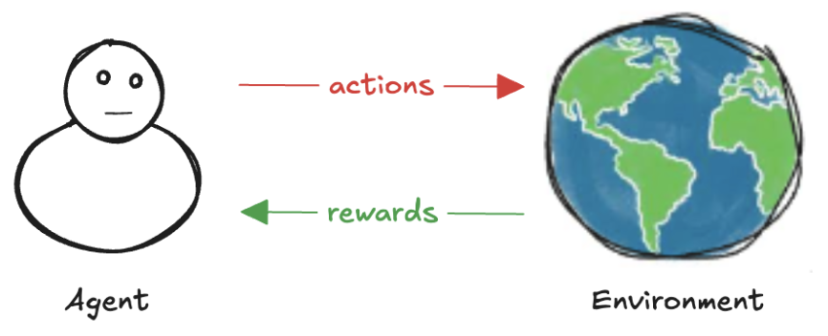
Agent and Environment
The agent is not told which actions to take, it must discover which actions provide the most reward by trying them on its environment
everything outside the agent
everything the agent has no total control over

Slide 5
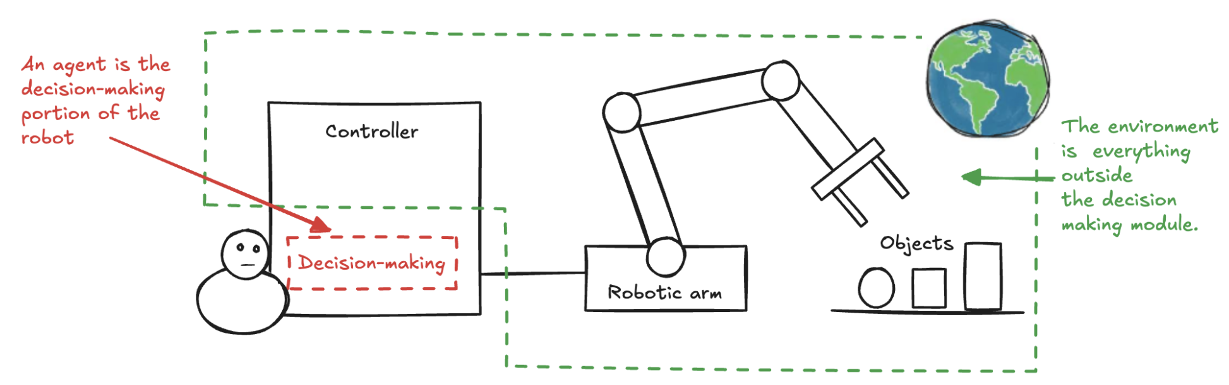
Boundary
Concrete example: a robot learning to pick up objects and place them in a container
The objects to be picked up, the tray where the objects lay, the wind, the robot arm and everything outside the decision maker are part of the environment

Slide 6
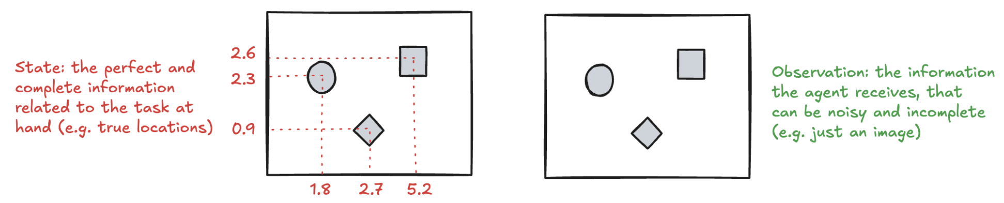
State and Observations
The environment is represented by a set of variables related to the problem
in the robotic arm example: location of objects, location and velocities of the arm
This set and all the possible values that variables can take are referred to as the state space
a state is an instantiation of the state space: a set of values the variables take
Often, agents don’t have access to the actual full state of the environment: the part of a state that the agent can observe is called an observation
in the robotic arm example, the agent may only have access to camera images

Slide 7
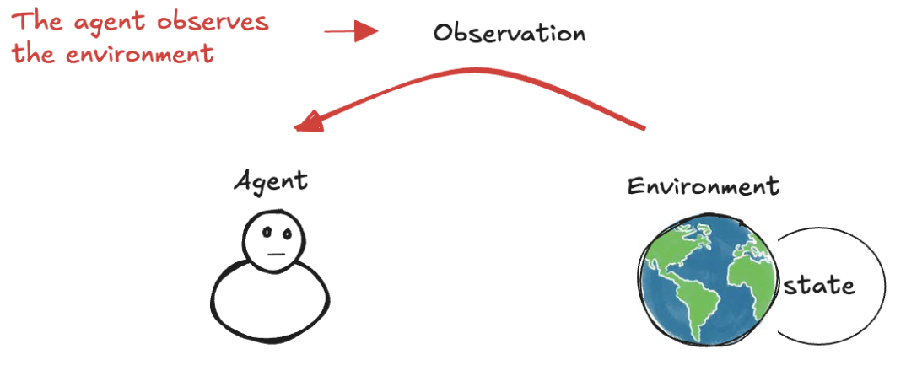
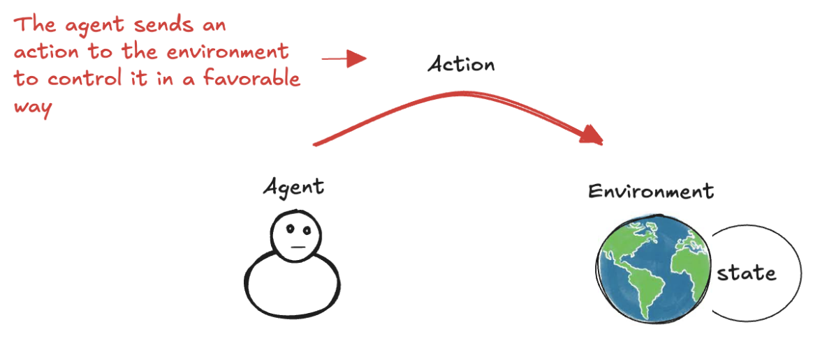
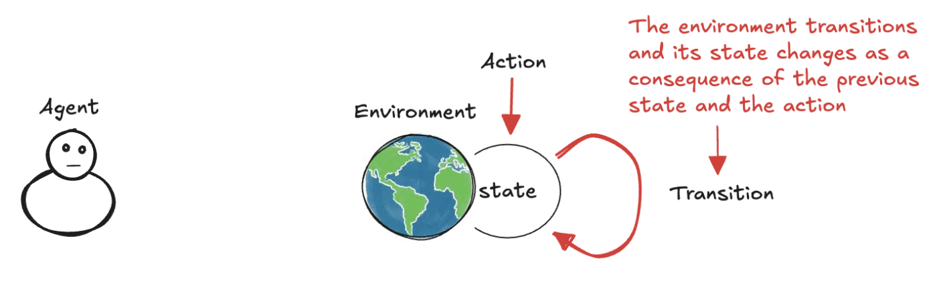
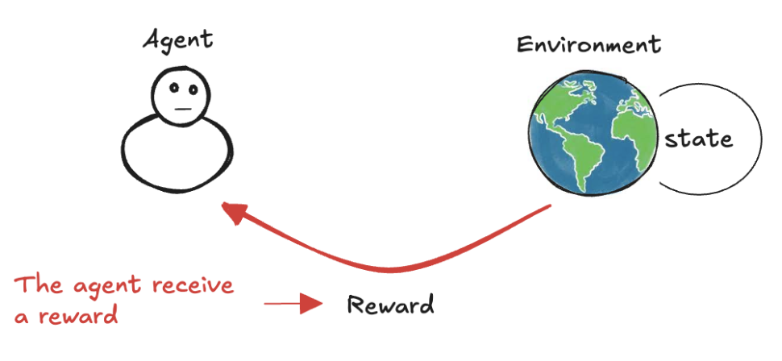
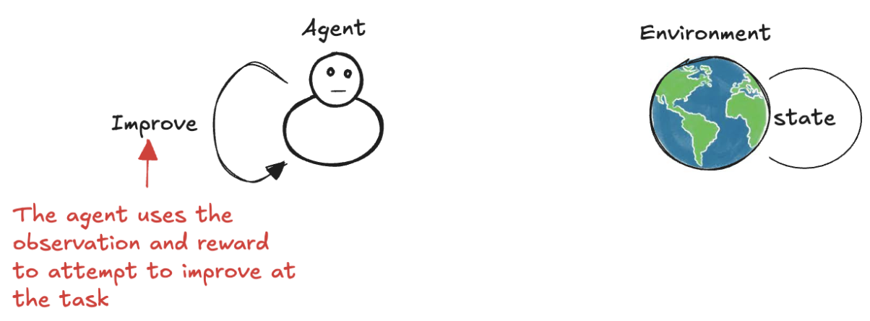
Actions and Rewards (1)
(1)
(2)
(3)
(4)
(5)

Slide 8
Actions and Rewards (2)
At each state, the environment makes available a set of actions the agent can choose from
the agent influences the environment through these actions
the environment may change states as a response to the agent’s action
transition function
The environment also provides a reward signal as a response
reward function
The set of transition and reward functions is referred to as the model of the environment
In the interesting and challenging cases, actions may affect not only the immediate reward and the next situation, but also all subsequent rewards

Slide 9
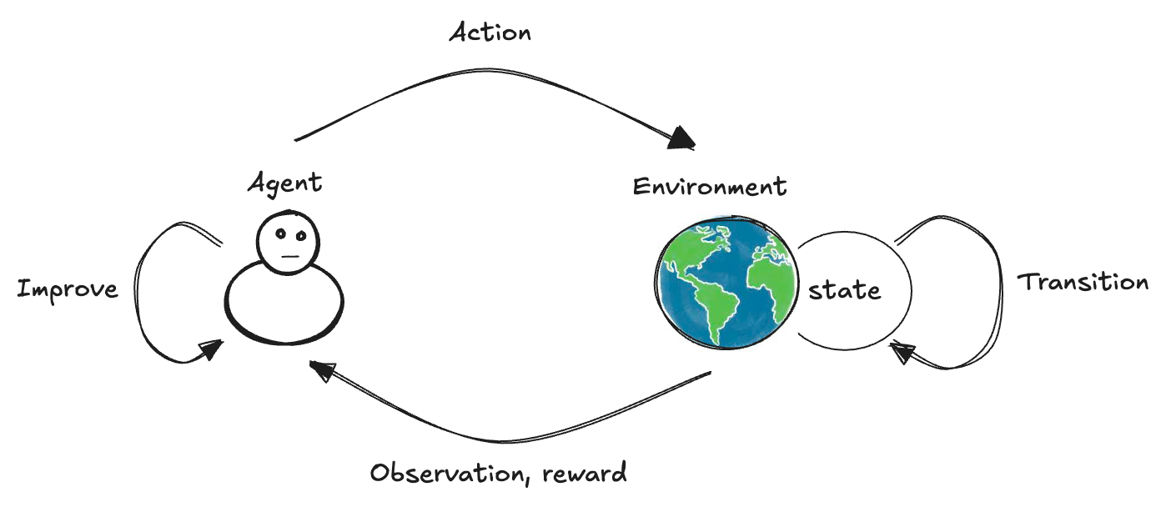
Steps and Episodes
The agent has a four-step process:
Observation of the environment
Interaction through actions
Evaluation through the reward signal
Improvement of its behaviour
Each cycle is called a time step
The set of [state, action, reward, new state] is called an experience
The task may or may not have a natural ending
tasks that have a natural ending (e.g. games) are called episodic tasks
tasks that don’t have a natural ending continuing tasks
The sequence of time steps from the beginning to the end of an episodic task is called an episode

Slide 10
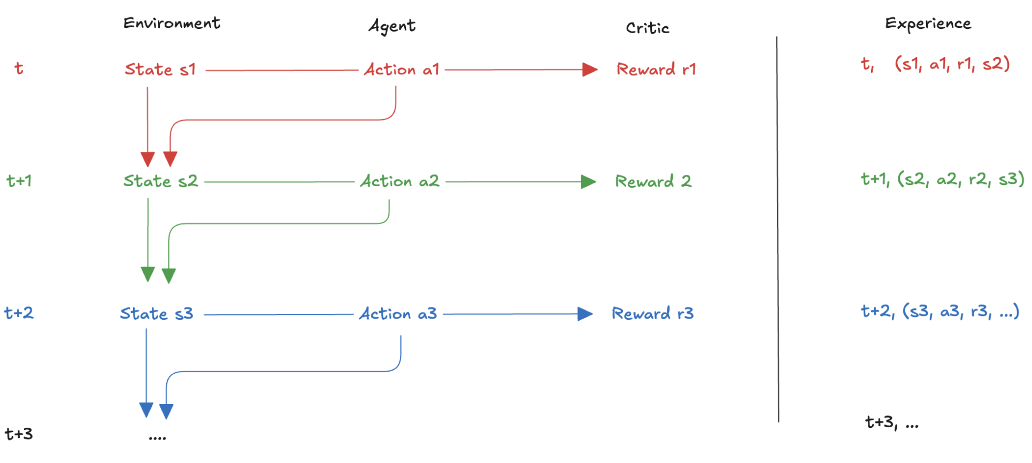
Experience

Slide 11
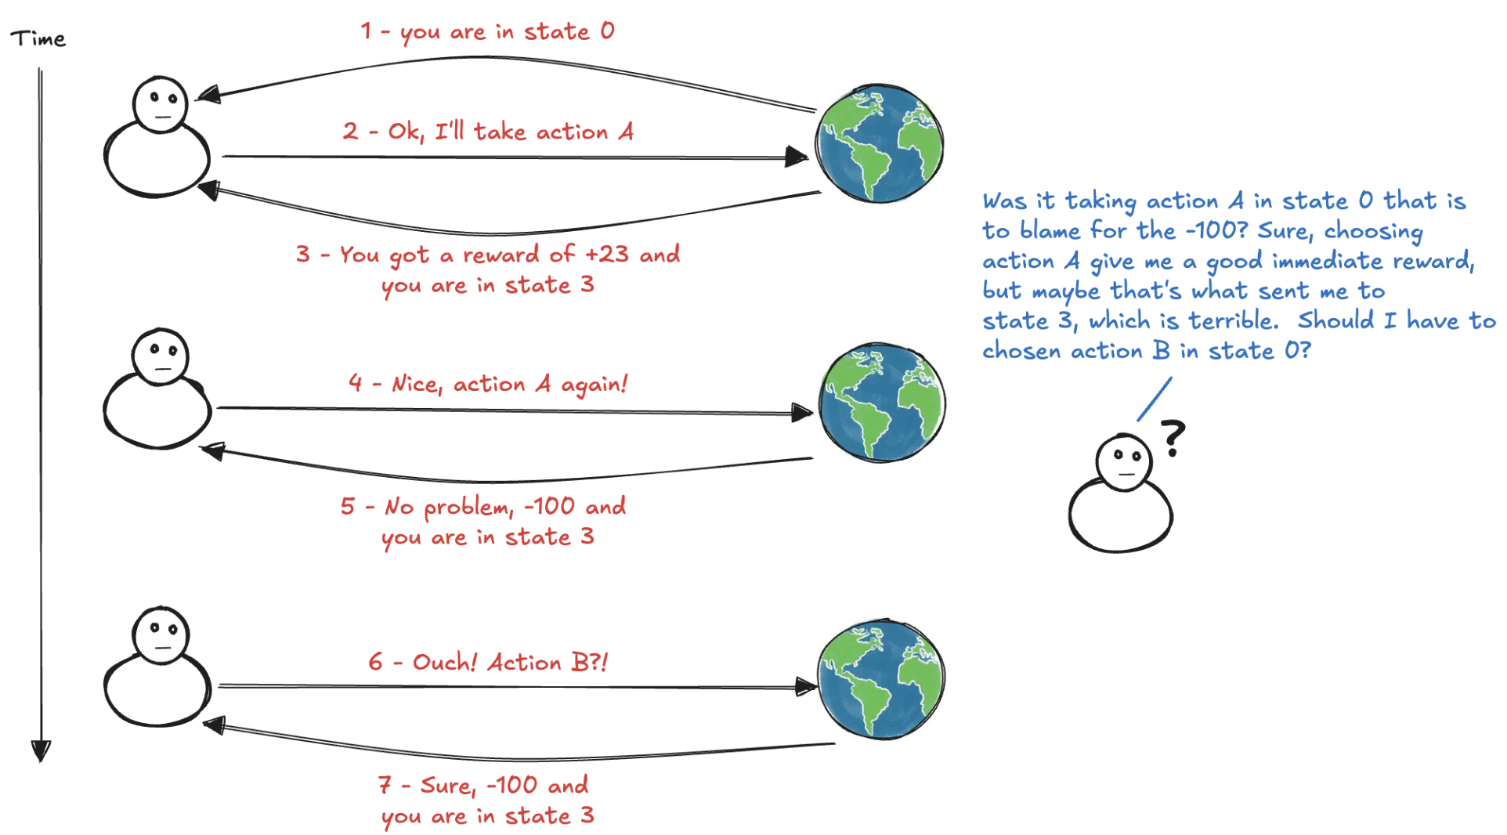
Challenges: delayed consequences
The reward may be sparse and only manifest after several time steps
How to determine which state/action is responsible for a reward?
temporal credit assignment problem

Slide 12
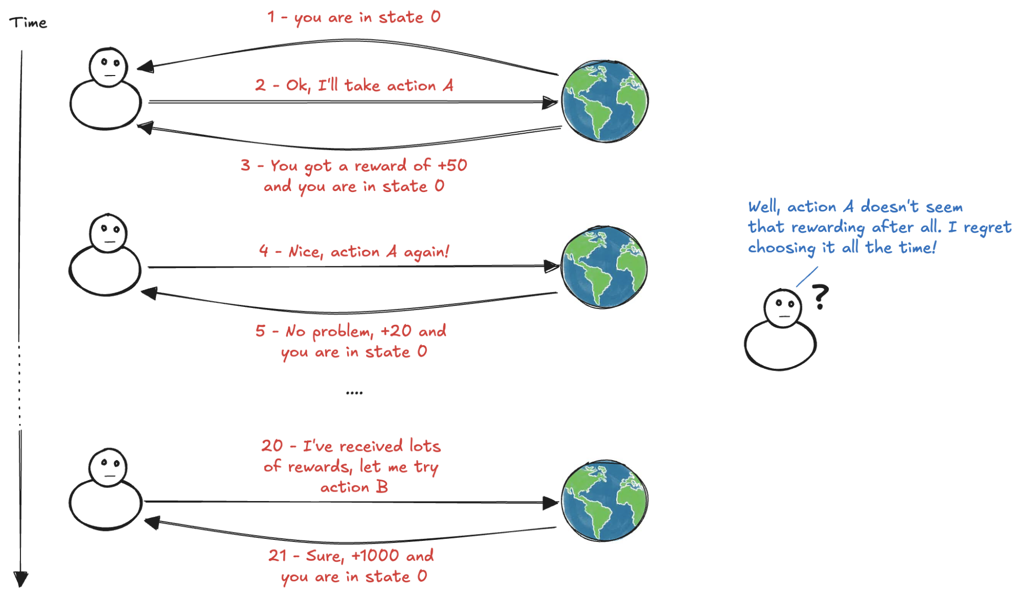
Challenges: exploration vs exploitation
Rewards provide evaluative feedback, no explicit supervision
no which action would have been correct
no what would have happened had it chosen differently
The agent must therefore explore alternative actions to discover better behaviors, while also exploiting what it has already learned.

Slide 13
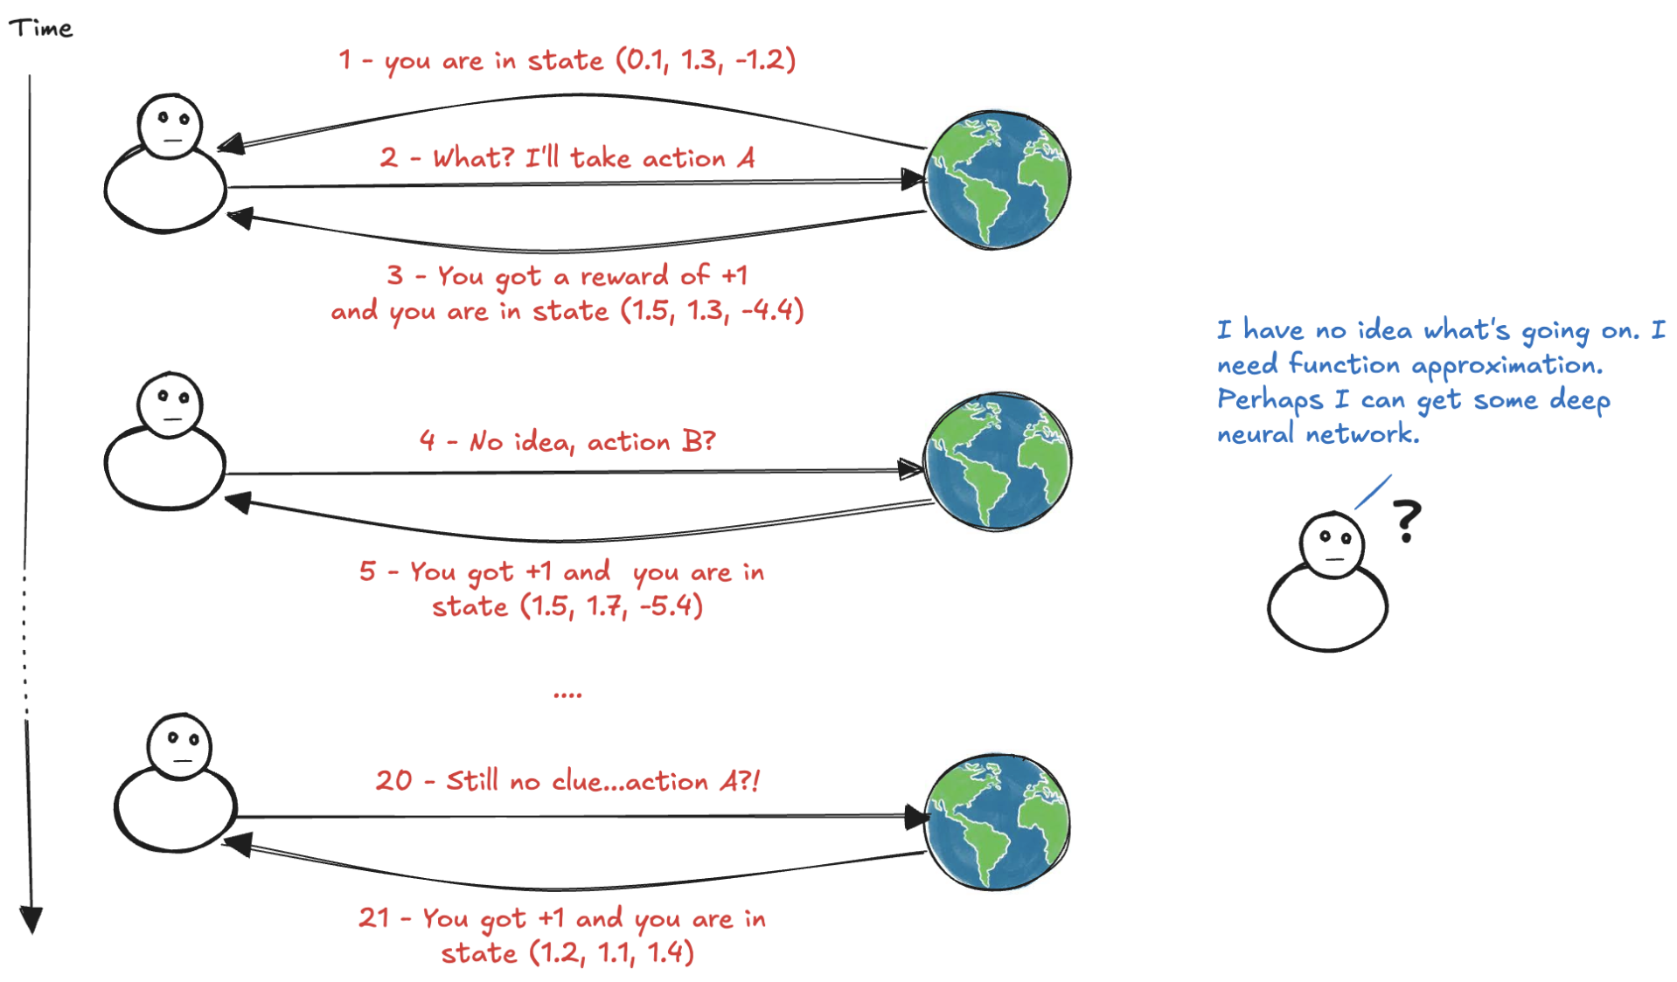
Challenges: sampled and weak feedback
The reward is just a sample: it doesn’t have access to the reward function
State and action spaces are commonly large, even infinite
The agent must be able to generalize

Slide 14






Markov Decision Process
A mathematical framework for sequential decision-making problems
Agent and environment interact at each time step of a sequence:
At each time step, the agent receives current state from a set of possible states:
The agent uses the information to select an action from a set of possible actions:
Because of this action, the environment generates a numerical reward:
Then, the environment transitions to a new state:
Repeating this interaction produces a trajectory:
State, action and reward are random variables

Slide 15
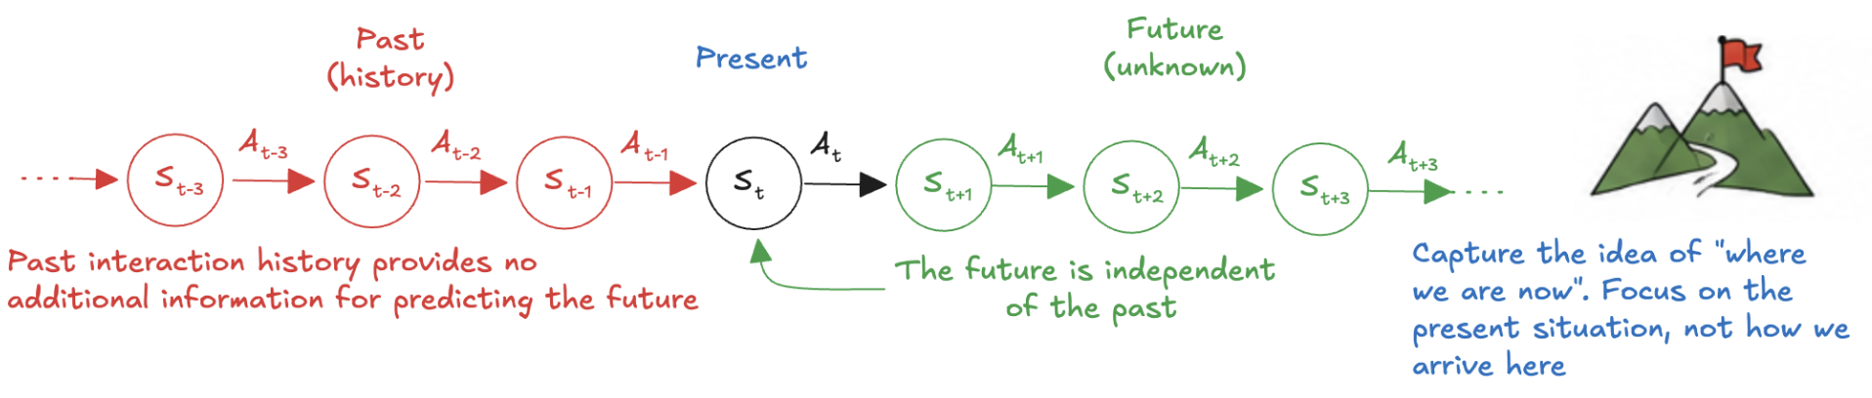
Markov Property
We assume that the probability of the next state, given the current state and action is independent of the history of interactions
lowercase letters denote particular values of the random variables and P denotes the probability of an event.
Probability of moving from one state to another state on two separate occasions, given the same action, is the same regardless of all previous states or actions encountered before that point

Slide 16

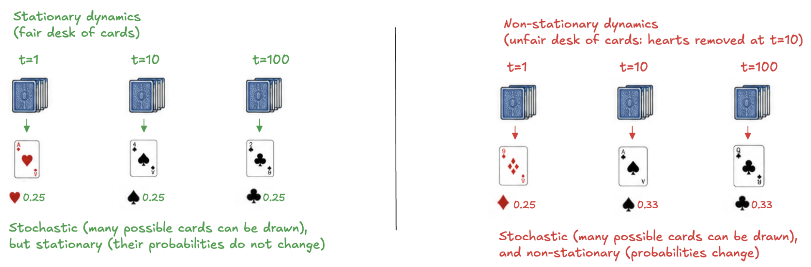
Stationarity
The probability of a given next state and reward, given a state-action pair, is the same at every time step:
The environment may still be highly stochastic (the same action in the same state can produce different outcomes) but the probabilities of those outcomes do not themselves change over time
Markov property and perfect stationarity are difficult to guarantee in real-world problems.

Slide 17
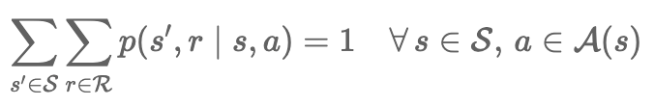
Environment dynamics
The way the environment responds to the agent
if the agent takes an action in a state, what can happen next, and with what probability?
Thanks to the stationarity assumption the one-step probability does not depend on t, so we use a lowercase shorthand that leaves the time index implicit:
(s,a) denote the current state and action,
(s',r) denote the resulting next state and reward
Given the current state and action values, the dynamics specifies the joint probability of every possible next-state–reward pair:
Because p is a probability distribution over all possible pairs state-reward, its probabilities must sum to one:

Slide 18
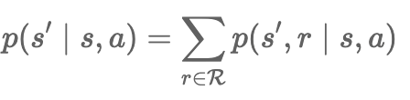
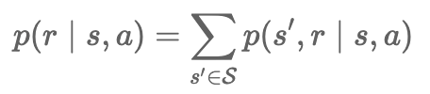
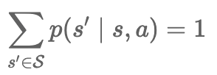
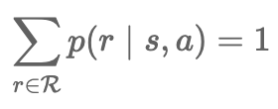
The Transition function
Starting from the joint dynamics, we can marginalize out the variable we do not need.
If we are interested only in where the environment moves next, regardless of the reward received, we sum over all possible rewards:
Analogously, if we are interested only in the reward produced by taking an action in a state, regardless of the next state reached, we marginalize over all possible next states:
Both distributions are normalized:

Slide 19
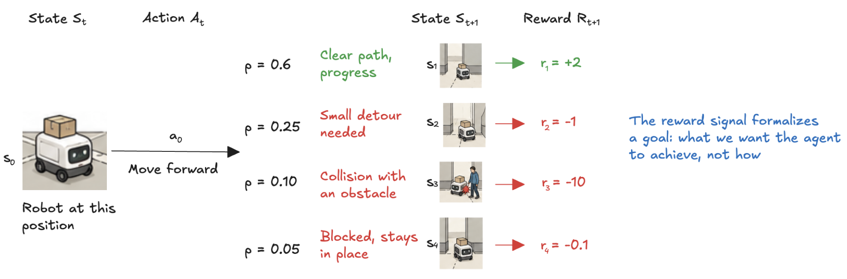
Reward hypothesis
All goals can be described as the maximization of the expected cumulative reward
to accomplish something, design the reward signal so that maximizing it leads the agent toward the behaviour we want
Reward signal should specify what we want to achieve, not how we want to achieve it
prior knowledge should generally not be encoded by rewarding actions simply because we believe they are useful
The agent should be allowed to discover effective behaviour through interaction.

Slide 20
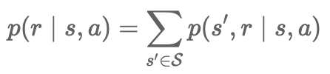

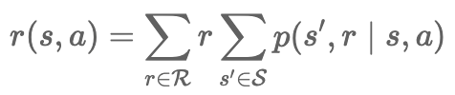
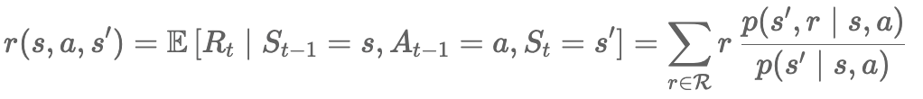

The Reward function
The reward signal is stochastic: same state-action pair may lead to different rewards on different transitions
The marginal distribution tells us how likely each reward value is after taking an action in a state, independently of which next state is reached
What is important is the expected reward for the state-action pair:
Equivalently, using the joint dynamics directly:
Sometimes we also want the expected reward of a specific transition:
The state-action reward can then be recovered by averaging:

Slide 21
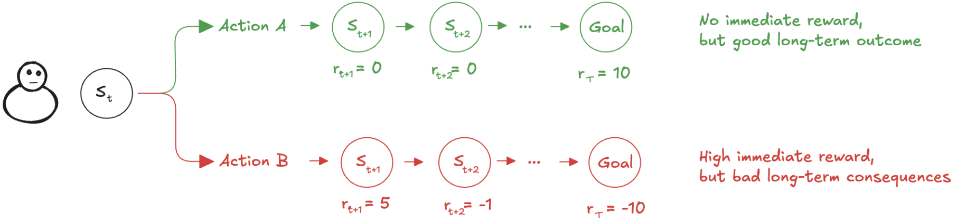
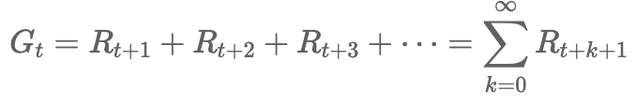
The Return
An agent should not evaluate an action only by the reward received immediately after taking it
a good action may produce little reward but lead to a desirable sequence of future rewards
an action that produces an immediate reward may have undesirable long-term consequences
The agent’s objective is therefore defined in terms of the cumulative reward received from a given time step onward:

Slide 22
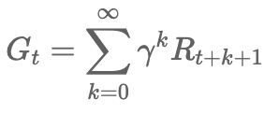

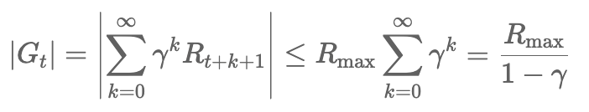
The Discount
For an episodic task, the interaction eventually reaches a terminal state, so the return is simply the finite sum of rewards received until the end of the episode.
For a continuing task, the interaction may proceed indefinitely, and this sum may not be finite.
To handle such case, and more generally to control the relative importance of immediate and future rewards, we introduce a discount factor:
For gamma<1, progressively distant rewards receive exponentially smaller weights, and (if rewards are bounded) the discounted return is also bounded:
The discounted return has an important recursive structure:
The current return can be viewed as the immediate reward plus the discounted return from the next time step

Slide 23
MDP framework
The MDP framework is abstract and flexible and can be applied to many different problems in many ways
actions can be low-level controls (the voltages applied to the motors of a robot arm)
or high-level decisions (whether to have lunch)
states can take a wide variety of forms
can be completely determined by low-level sensations (direct sensor readings)
can be more high-level and abstract (symbolic descriptions of objects in a room)
In general, actions can be any decisions we want to learn how to make, and the states can be anything we can know that might be useful in making them!
There are many extensions to the framework
Partially observable Markov decision process: when the agent cannot fully observe the environment state
Continuous Markov decision process: when time, action, state or any combination of them are continuous
Multi-agent Markov decision process: to allows the inclusion of multiple agents in the same environment

Slide 24
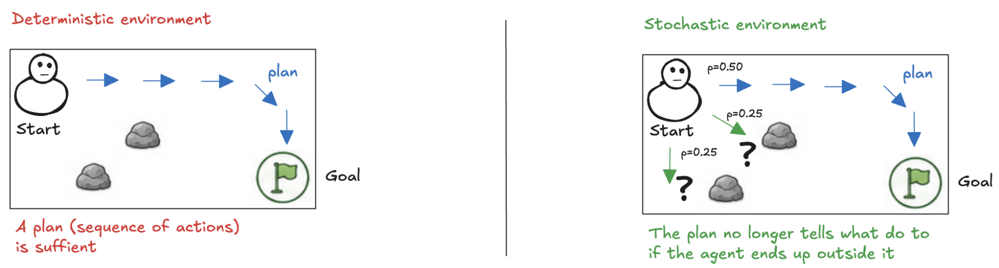

Plan and Policy
It might seem that the agent’s goal is to find a plan: a sequence of actions that leads from the initial state to the desired outcome, maximizing the return.
In a deterministic environment (every action has a predictable consequence), such a sequence may be sufficient
But what happens is a stochastic environment? An action may not produce the intended outcome, and the agent may reach a state not anticipated by the plan.
A fixed sequence of actions no longer tells the agent what to do
We need a policy: a decision rule that specifies what the agent should do in every state it may encounter

Slide 25

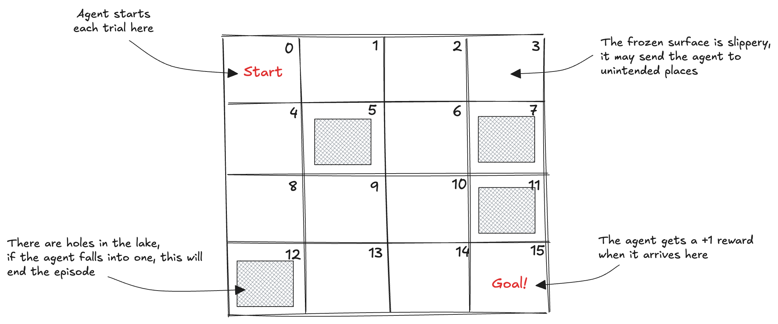
Example: the frozen lake (1)
A simple grid-world environment
discrete state and action spaces
the task is to go from a start to a goal location, avoiding falling into holes
the challenge is that the surface is slippery: the agent moves only a third of the time as intended, the other two-thirds are split evenly in orthogonal directions

Slide 26
Example: the frozen lake (2)
The state is composed of a single variable: the id of the cell where the agent is at any given time
the size of the state space is 16 (the ids are set from 0 to 15, left to right, top to bottom)
There’s only one starting state (which is state 0)
Five terminal states
There are four available actions in all states
Up, Down, Right, or Left
The environment is stochastic
the probability of the next state 𝑠′ given the current state 𝑠 and action 𝑎 is less than 1
there are more than one possible next state
The reward function is +1 for landing in state 15, 0 otherwise

Slide 27
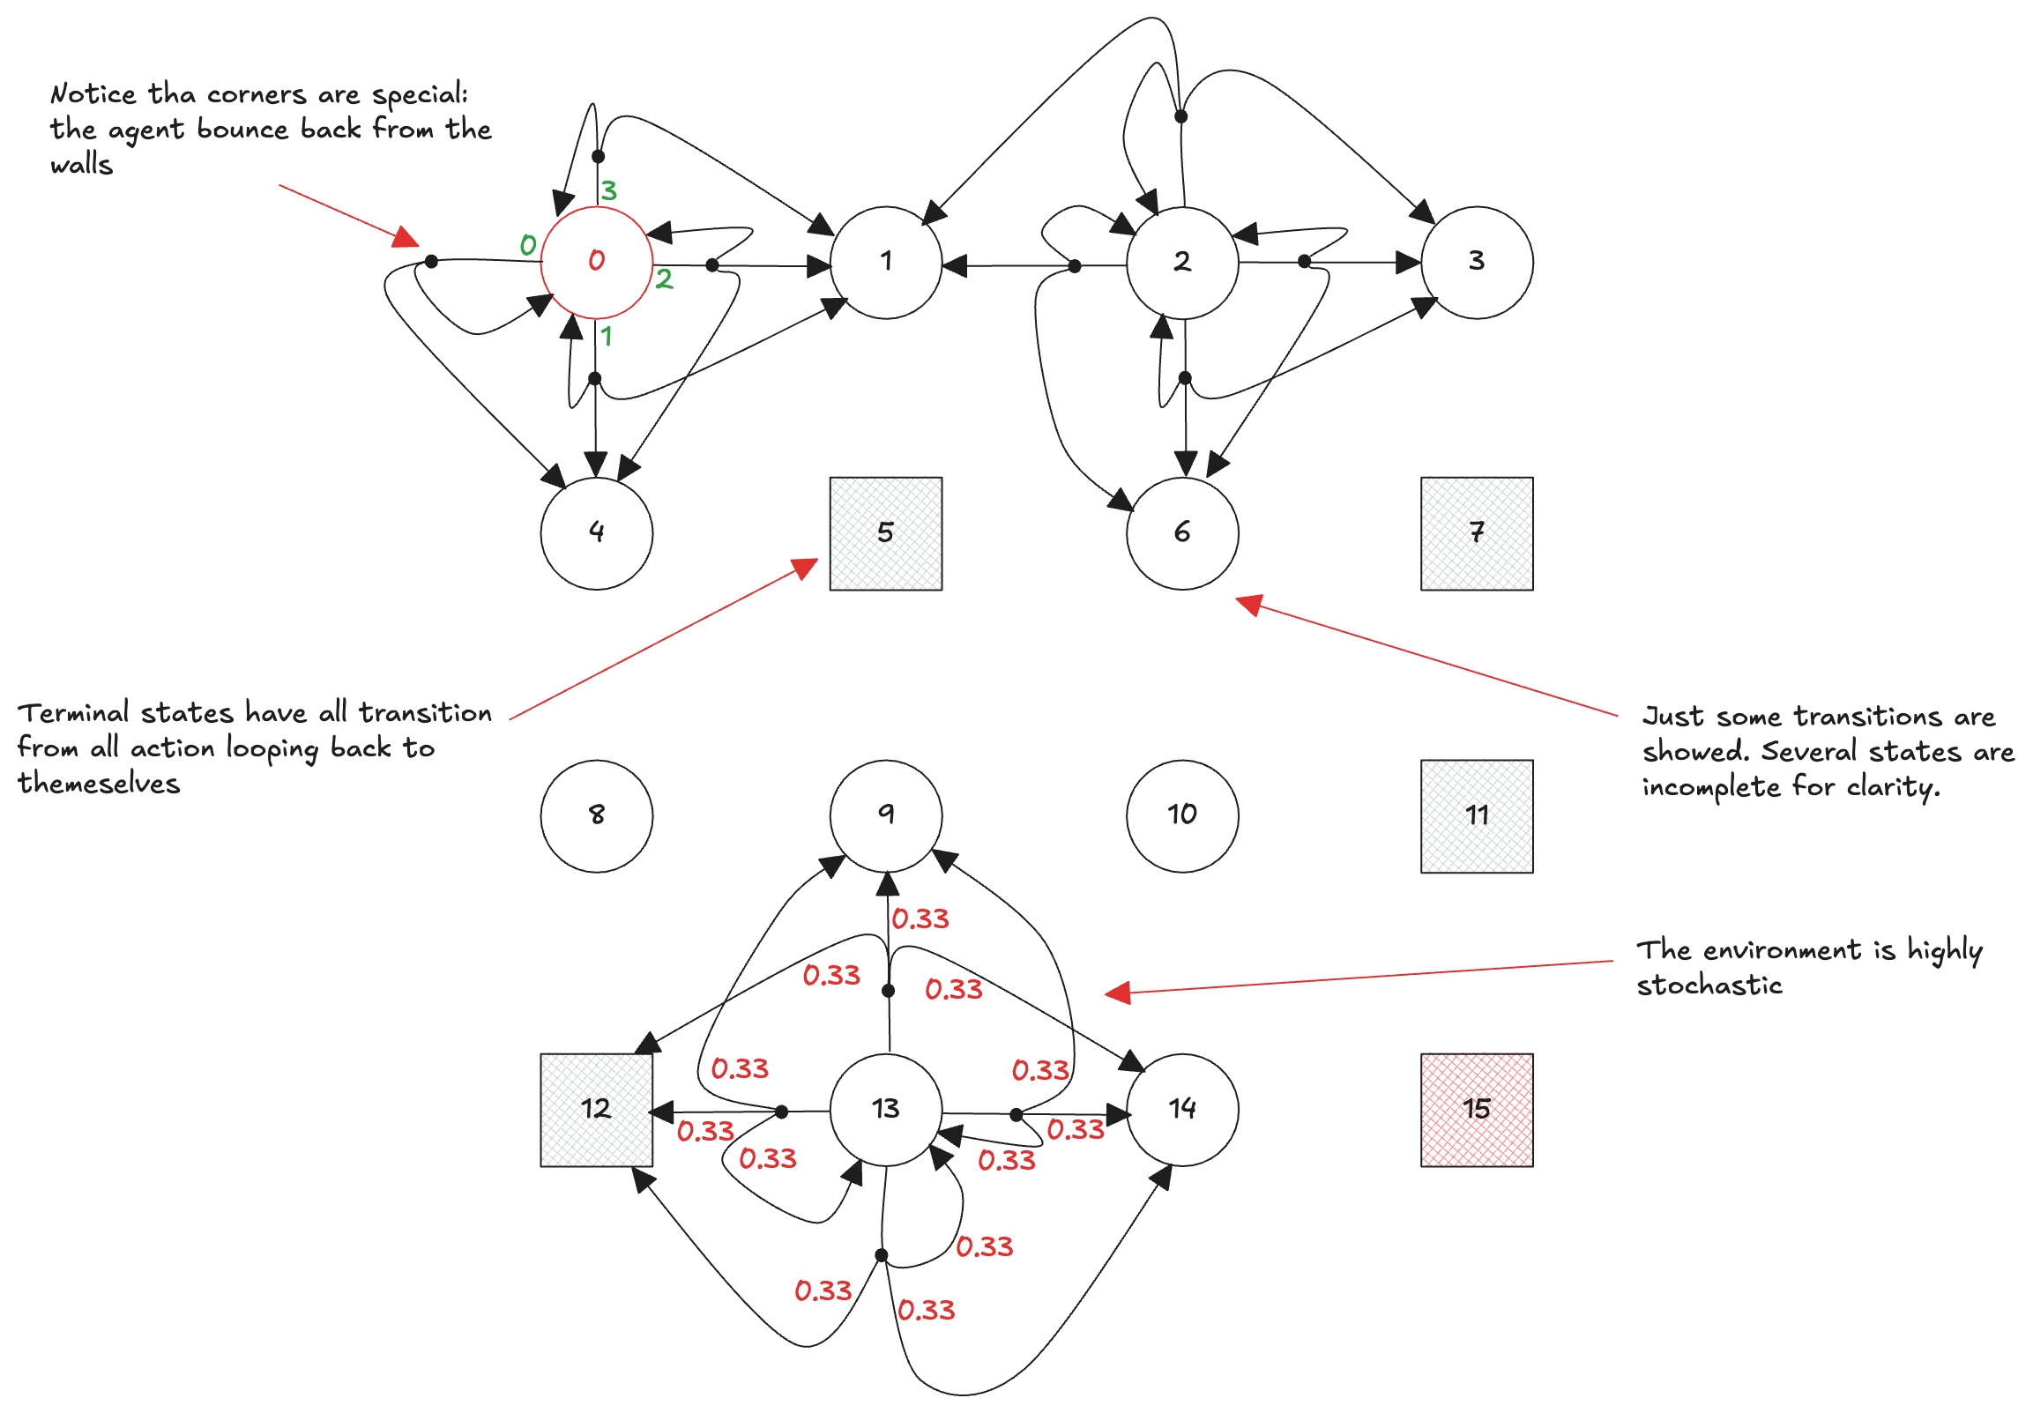
Example: the frozen lake (3)

